Slide 1
Customer Churn
Prediction
Business Presentation
Adam Littman

Slide 2
Contents
Business Problem Overview
Solution Approach
Data Overview
Exploratory Data Analysis (EDA)
Model Performance Summary
Business Insights and Recommendations

Slide 3
Business Problem Overview
The company is facing competition in the market and is experiencing customer churn.
The company would like to minimize future churn.
The company would like to develop a model that will predict potential churners.
The company would like to provide segmented offers to those potential churners.

Slide 4
Solution Approach
We will:
Build different models to identify potential churners.
Tune the top-performing models to maximize their efficiency and accuracy.
Compare the models, then build a final model based on the best-performing model.
Identify important features for providing segmented offers.

Slide 5
Data Overview
The data contains information about 11260 accounts, and 19 features.
The features include:
Account ID, If the account churned (Target variable), Tenure of the account, City Tier, Number of contacts (last 12 months), Preferred payment method, Gender of primary customer on account, Service satisfaction score, Number of customers on account, Account segment, Customer Care satisfaction score, Marital status, Monthly avg revenue of account (last 12 months), Complaints over last 12 months (Y/N), Revenue growth percentage of account (yoy last 2 years), Coupons used (last 12 months), Days since customer care contact, Monthly avg cashback (last 12 months), Preferred login device.

Slide 6
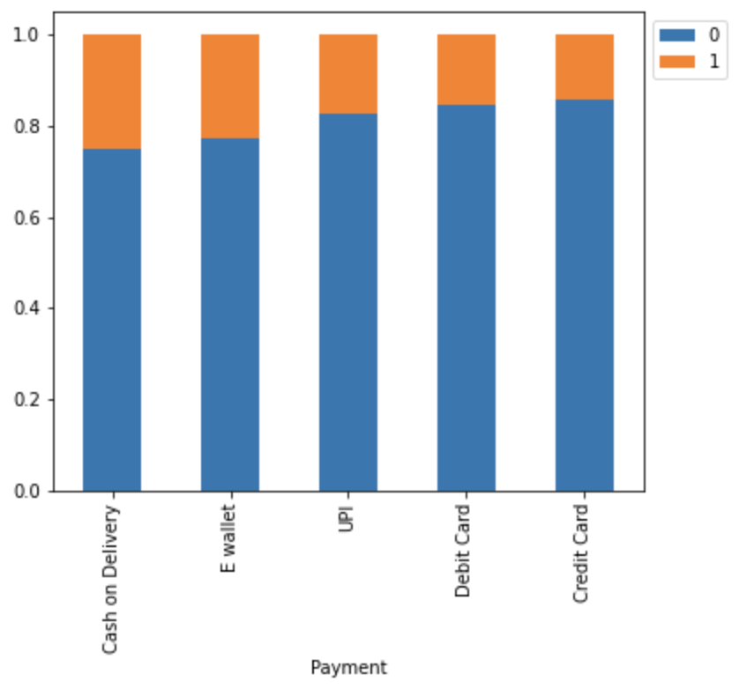
Exploratory Data Analysis
Accounts that pay via ‘Cash on Delivery’ and ‘E Wallet’ are most likely to churn.

Slide 7
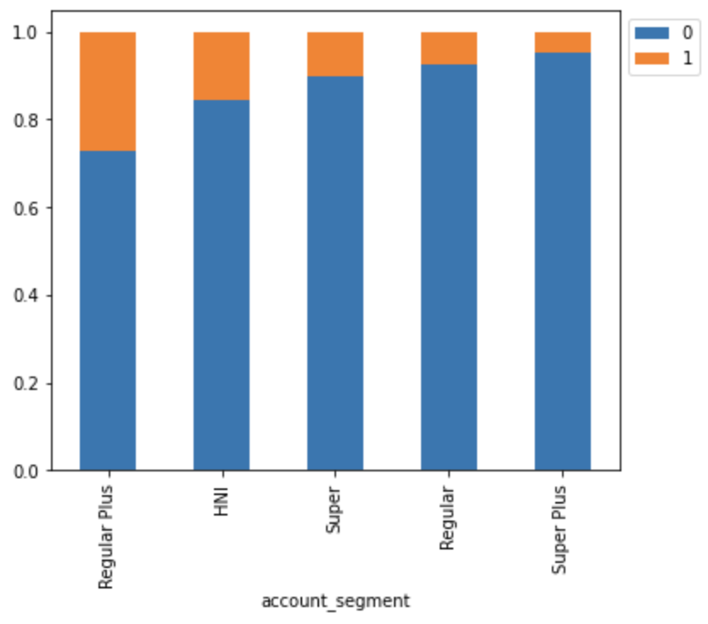
Exploratory Data Analysis
‘Regular Plus’ accounts are most likely to churn, followed by ‘HNI’.

Slide 8
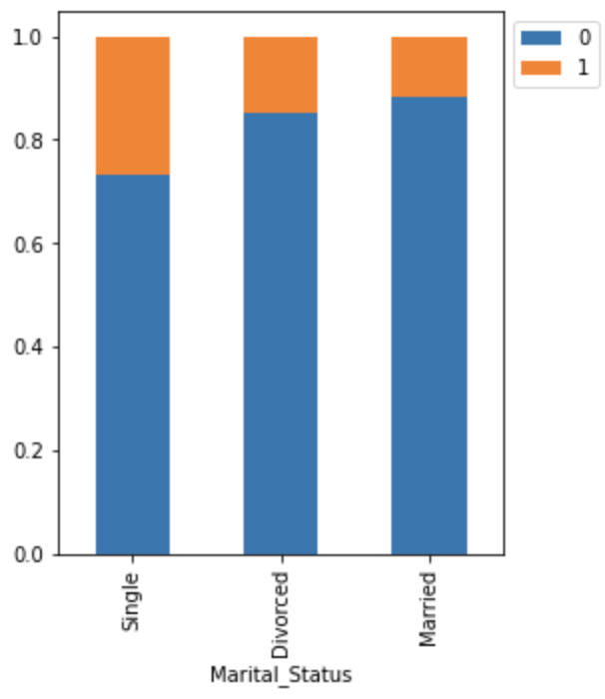
Exploratory Data Analysis
‘Single’ accounts are most likely to churn.

Slide 9
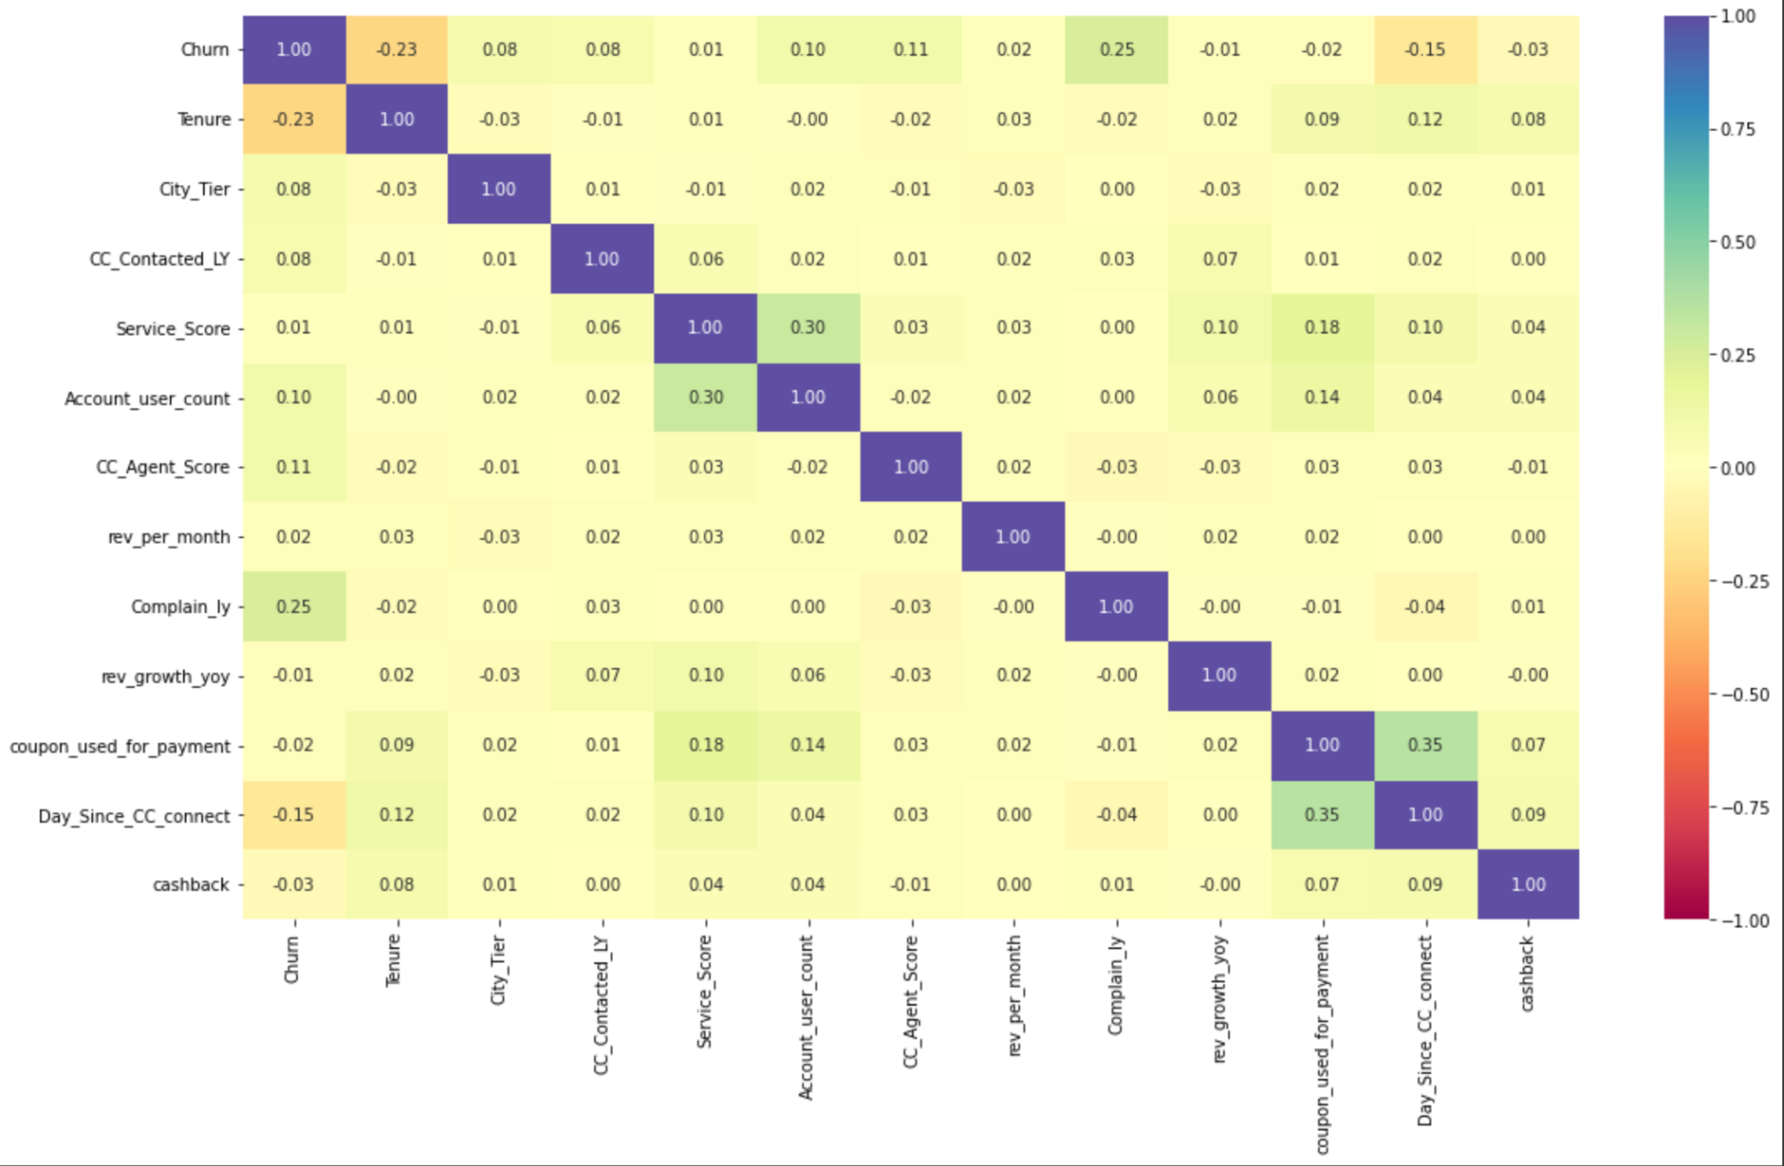
Exploratory Data Analysis
There is very little correlation between any of the variables, so multicollinearity will not be an issue.

Slide 10
Model Building
Split the dataset into training, validation, and test data.
Impute missing values using KNN Imputer.
Choose model performance evaluation metric: Recall – (This will allow us to minimize false negatives).
Build a variety of bagging and boosting classification models
Test Oversampling and Undersampling.
Choose the top 3 best-performing models and tune them using GridSearchCV and RandomizedSearchCV.
Compare the models and determine the best-performing model.
Build a pipeline to standardize the model in preparation for fresh data.

Slide 11
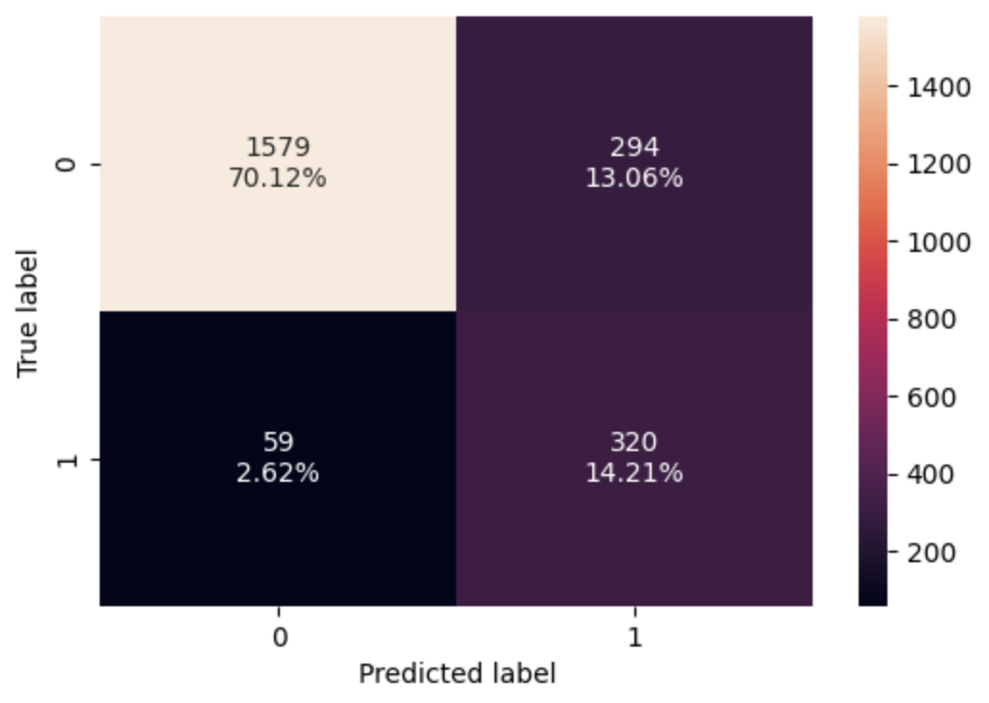
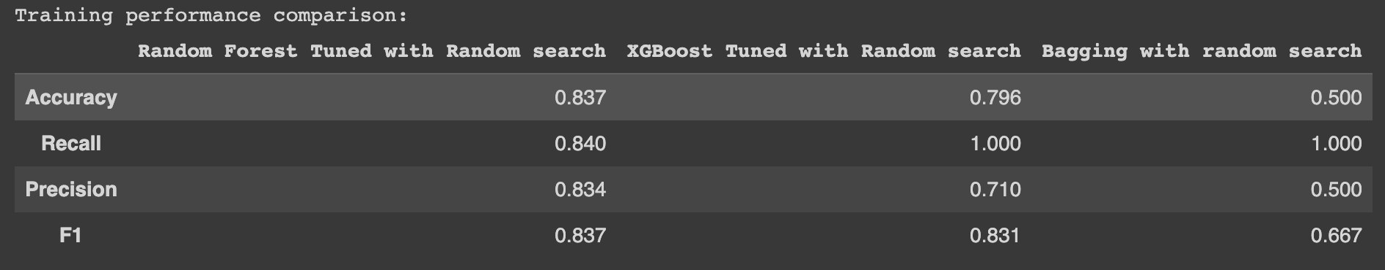
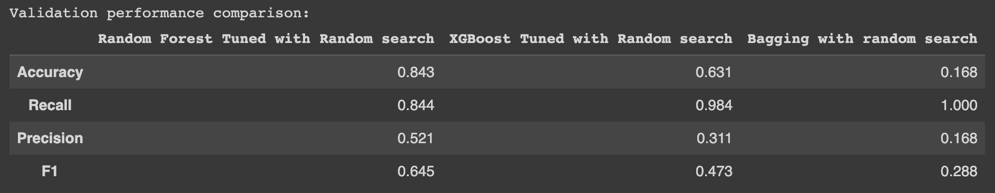
Final Model: Random Forest Classifier
Random Forest returned the strongest overall results using Undersampled data.
Below: XGBoost and Bagging have very strong recall, but are overfitting the data.

Slide 12
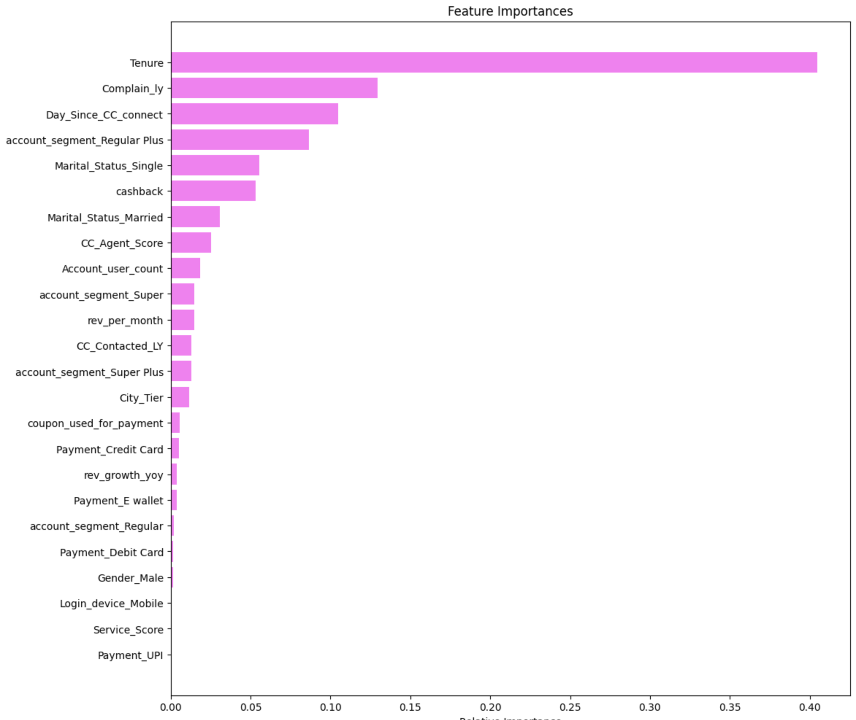
Feature Importance
Tenure of the account is the most important variable in predicting customer churn.
Also important features:
If the account issued a complaint within the past 12 months.
Days since the account contacted Customer Care.
If the account is a Regular Plus account.

Slide 13
Business Insights and Recommendations
The following accounts are most likely to attrite, and could be targeted with offers:
New accounts that were set up within the past 12 months
Accounts that issued at least one complaint within the past 12 months
Accounts that have contacted customer care within the past 3 months
‘Regular Plus’ accounts

